Slide 1

Group Members: Dakota Chanthakoummane, Aryan Kharva, Jade Lowe, Quintin Obey, Connor Smith, and Edward Tobiasson

Slide 2



Introduction
We have numerous features implemented in Potato Properties’ web application.
The intended audience of the Potato Properties’ site is for residents of the property.
The scope of the website encompasses user authentication for multiple users and users types.

Slide 3
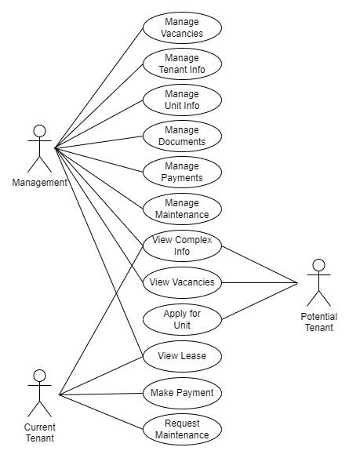
Overall Description
User needs are dependent on the type of user logging into the system. This includes…
Management Users
Potential Tenant Users
Current Tenant users
Assumptions and Dependencies
Constraints

Slide 4
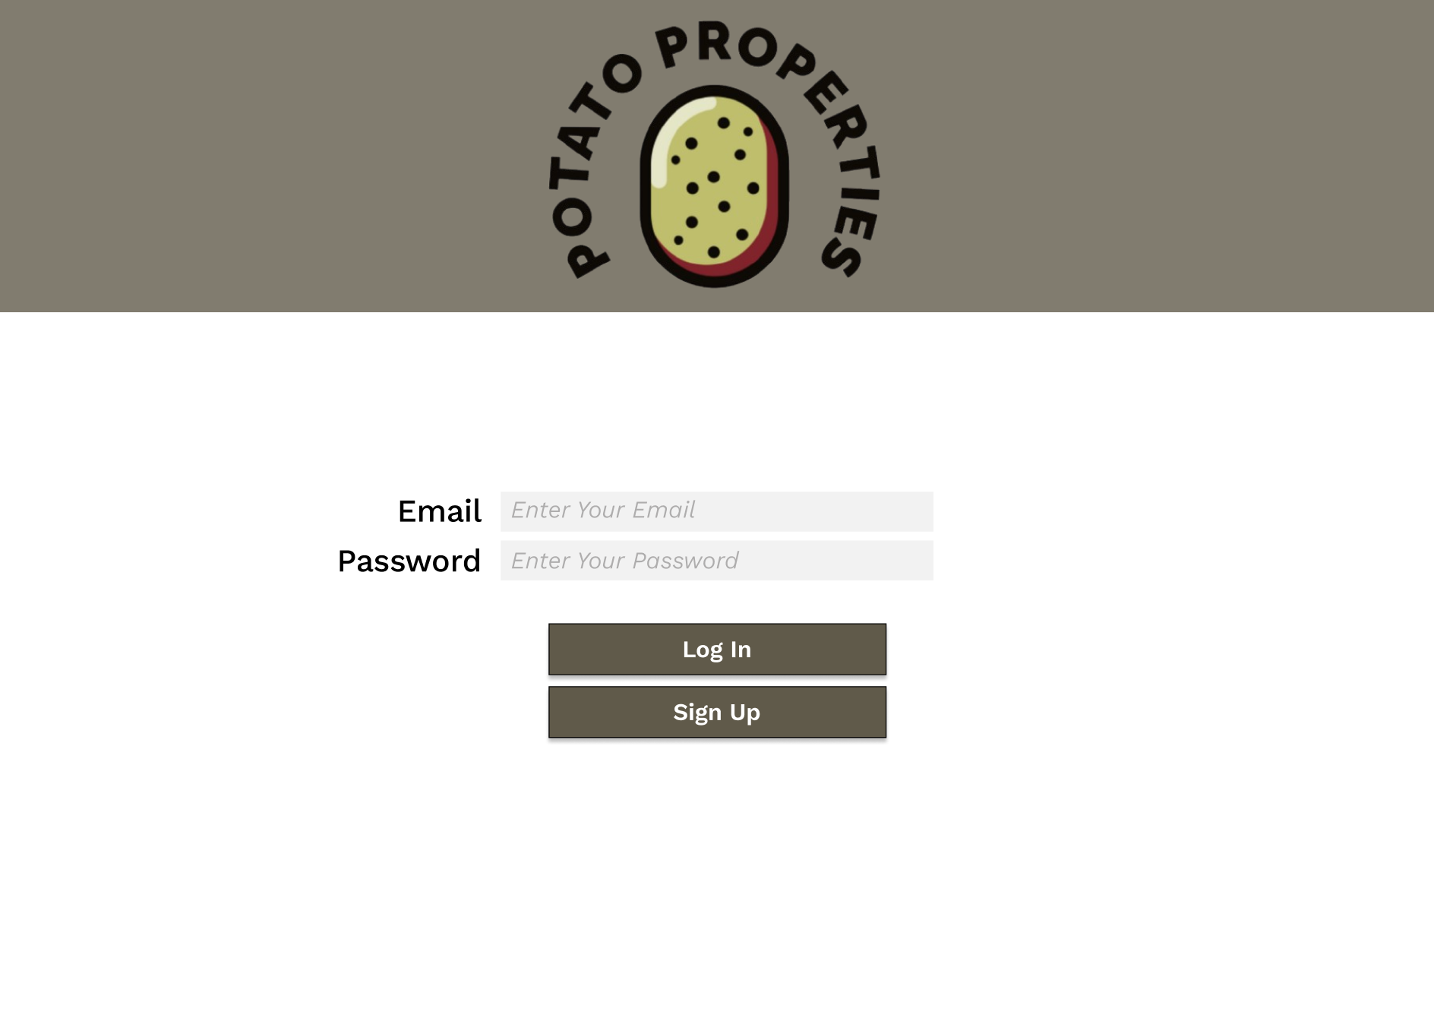
System Features and Requirements
User Interface
Homepage
Tenant Dashboard
Maintenance Requests
Contact Us
Initial prototype for the login page of our site.

Slide 5
System Features and Requirements
Host SQL Database
Track Potential Tenants
Tenant Administration

Slide 6
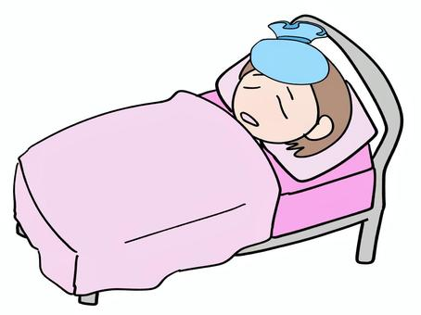
Risk Management #1: Severe Illness
Probability: Medium
Impact: Serious
Monitoring: Meet every few days to assess the conditions of each affected member to analyze progress speed.
Mitigation: Change the requirements for each member of the team or adjust to what is needed depending on the member’s condition.

Slide 7
Risk Management #2: Unfamiliar technology
Probability: Medium
Impact: Moderate
Monitoring: Provide resources of the current software or language to members who are not as familiar while still assigning light work to practice.
Mitigation: Provide members with the most expertise on the subject of lead operation, while also using documentation for members to provide guidance.

Slide 8
Risk Management #3: Team member withdraw
Probability: Low
Impact: Moderate
Monitoring: Analysis of the progress that the absent member has made throughout the project.
Mitigation: Assign or split up the unoccupied work that is left behind to the correct members to assess.

Slide 9
Risk Management #4: Time Constraints
Impact: Serious
Monitoring: While it is tempting to include every idea, it is important to prioritize essential functions that would directly impact user experiences.
Mitigation: Break the project into manageable phases with clear deadlines for each release. With this approach, we are then able to track progress and adjust the workload when necessary.

Slide 10
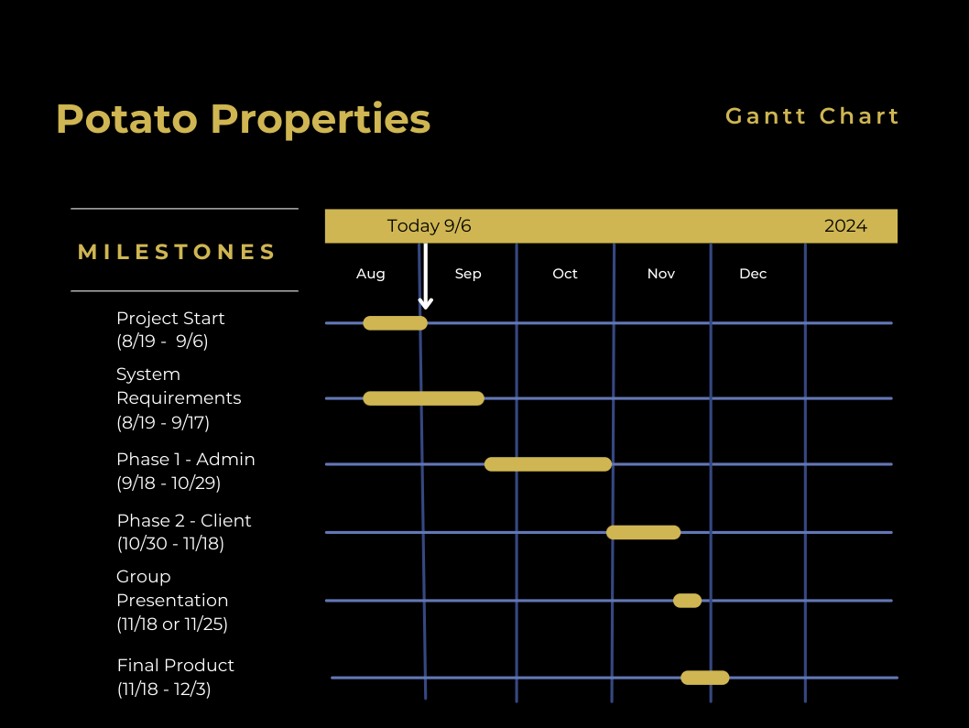
Gantt Chart

Slide 11
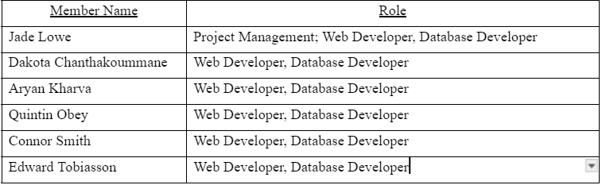
Team Member Roles

Slide 12
Thank You

